Slide 1

COMP90050
Advanced Database Systems
Winter Semester, 2023
Lecturer: Farhana Choudhury (PhD)
Live lecture – week 1

Slide 2
Logistic Information
Winter Semester, 2023 - Dual delivery
Lectures Each Week: A combination of pre-recorded and live sessions
Monday lectures will be pre-recorded and uploaded in Canvas
Tuesday 11:00 - 2:00 will be conducted on-campus + broadcasted live via Zoom + will be available in lecture capture
Notes:
Show zoom link in canvas

Slide 3
Logistic Information Contd
Tutorials: one 3-hour tutorial per week
Starts from week 1
Some tutorials are conducted on-campus, and some are online as zoom sessions, links are on Canvas now
Every student has to enrol to a tutorial officially
First tutorial will cover details on the group project expectations and some other topics from week 1’s lectures

Slide 4
Logistic Information Contd
References:
Transaction Processing, Jim Gray and Andreas Reuter, Morgan Kaufmann, 1992
Database system concepts, Abraham Silberschatz, Henry F. Korth, S. Sudarshan, 2011
We will not read this book cover to cover, slides are the main source of contents
Both books are available online from UniMelb library
Notes:
Show how to access the books

Slide 5
Logistic Information Contd
All the key information are available on Canvas:
You need to check it a few times a week for being up to date on discussions and announcements
It has also other basic info such as contact info for us
Find project specs and other assessments
Where submissions are made
Where you can find lecture capture and other materials

Slide 6
Assessments
  Online quizzes – 5 quizzes worth 2% each (2 in Week 2, 2 in Week 3, and 1 in Week 4)
    -Will be open on Monday 11am, closes on Tuesday 11am
    -20 minutes strict time to complete
  Project – survey report and oral presentation on a database research topic (40%) as a group of 4 students (presentation 15% + Report 25%)
  Final examination (50%)
Notes:
- These are preparations for the final exam, attempt them genuinely to see how you are doing

Slide 7
Project
Step 1: Form a group of 4 students by 2 July, 2023, 11:59pm
Step 2: Pick a topic of your interest from a list of candidate topics provided, by 2 July, 2023, 11:59pm
Canvas has details about the projects already: Read and Start with the steps above.
  Presentation: During Week 4 (schedule will be uploaded)
  Report submission due data: 24 July 2023, 11:59pm

Slide 8
Project
All members of a group should contribute to the project. If there is significant difference among group members, we reserve the right to differentiate marks.
Note that, there is an individual reflection component, where the members of a group will receive individual marks.

Slide 9
Who we are and Contact Info/Mode
Lecturer and subject coordinator
Dr. Farhana Choudhury
farhana.Choudhury@unimelb.edu.au
Head tutor
Tawfiq Islam (tawfiqul.islam@unimelb.edu.au)
Other tutors
Ahmad Asgharian Rezaei (a.asghariyan.rezayi@gmail.com)
Lakmal Muthugama tmuthugama@student.unimelb.edu.au
Daniel Gong <d.gong@unimelb.edu.au>
David Alexander Tedjopurnomo <davidtedjopurnomo@gmail.com>
BUT Ed DISCUSSION and ANNOUNCEMENTS first!

Slide 10
Discussion on the topics of the pre-recorded lecture and additional contents

Slide 11
Core Concepts of Database management system
Efficiency
- Disks and I/O bandwidth
- Main memory
- Type of architecture
Database performance metrics
Hardware
Software/ DB tuning
- Types of DB
- Indexing
- Query optimisation
Efficiency/speed
Effectiveness
Effectiveness
Concurrent users
Security & Reliability
Transactions
Reliability
Crash recovery
Fault tolerance
Data duplication

Slide 12
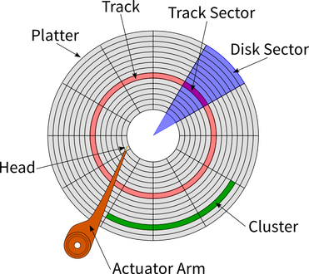
Basic Hardware of a classical disk
Rapidly rotating
- Tracks: circular path on disk surface
- Tracks are subdivided into disk sectors
with magnetic head, which reads
and writes data to the platter surfaces

Slide 13
SSD (Solid-State Drive/Solid-State Disk)
No moving parts like Hard Disk Drive (HDD)
No seek/rotational latency
No start-up times like HDD

Slide 14
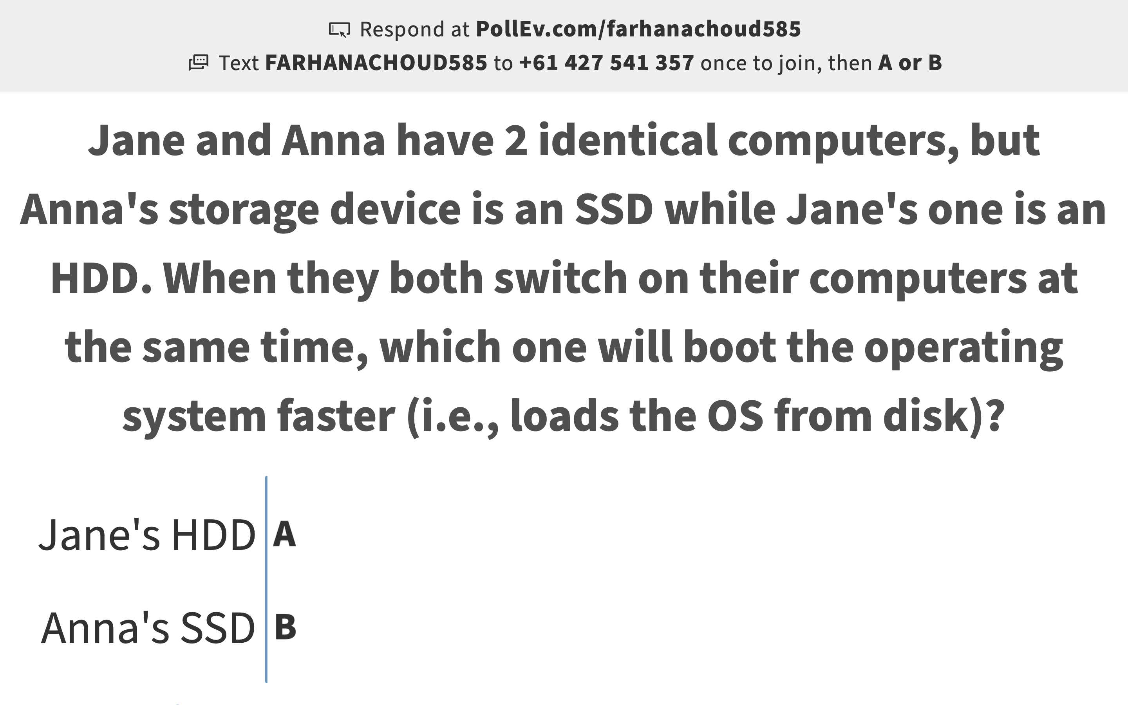
Pollev.com/farhanachoud585

Slide 15
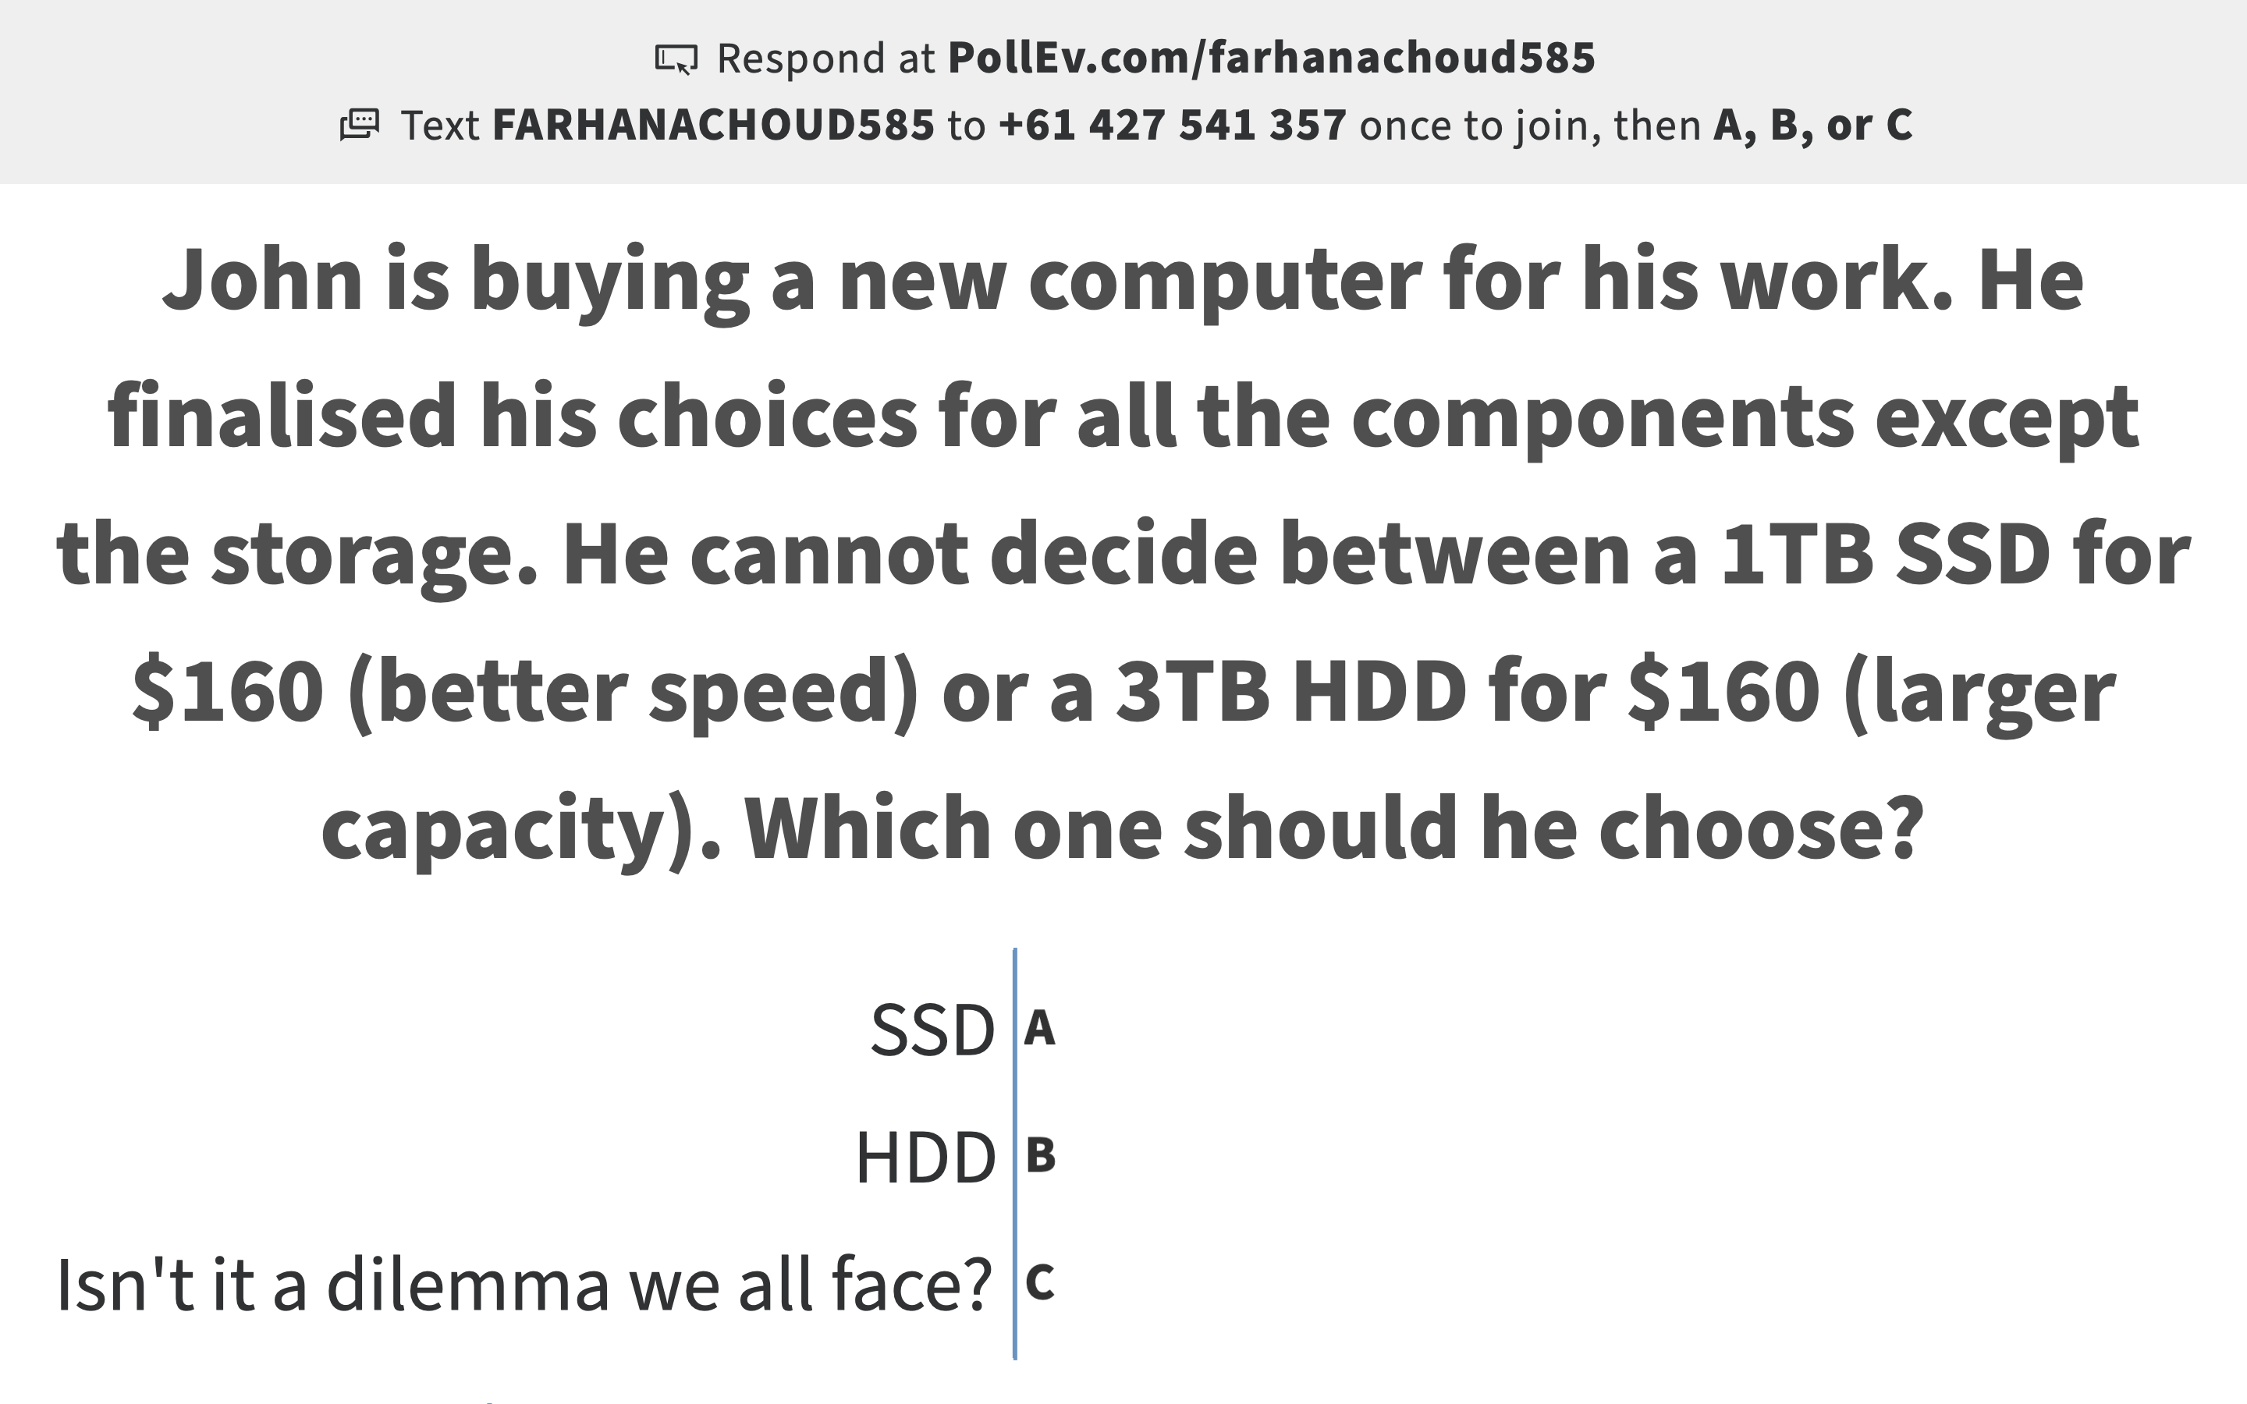
Pollev.com/farhanachoud585
What if some more contexts are given?

Slide 16
Disk access
Disk access time for HDD
What is the Disk access time for a transfer size of 8KB, when average seek time is 12 ms, rotation delay 4 ms, transfer rate 4MB/sec?
Disk access time for SSD
Solve related problems in tutorials
Disk access time =

Slide 17
So where do we store data:
The Memory Hierarchy
Basic structure
Processor
Regs
On chip
L1 Cache
There is usually
10-100 times
drop in
access
speed from on
Chip to off
chip
L2 Cache
Off chip
Main Memory
Harddisk

Slide 18
Memory hierarchy
Effective memory access time,
EA = H*C+(1-H)*M
where H = hit ratio,
C = cache access time;
M = memory access time
Processor
Regs
H times from
Cache
Caches
On chip
Remaining
(1-H) times
from memory
Main Memory
Off chip
Hit ratio | Effective access time as multiple of C, M = 100 C
50.00% | 50.5
90.00% | 10.9
99.90% | 1.1
Solve related problems in tutorials

Slide 19
What does this all mean?
Harddisk was the foundation stone for many DBMS design choices
What if CPU problems dominate?
Another recent player is networking:
  More and more databases are distributed
  The network hardware speeds are at the speed of light already
  Can this be the next determining front for DBMS design choices?
  Some of these are already at play in various new systems!

Slide 20
Core Concepts of Database management system
Efficiency
- Disks and I/O bandwidth
- Main memory
- Type of architecture
Database performance metrics
Hardware
Software/ DB tuning
Communication network
- Types of DB
- Indexing
- Query optimisation
Efficiency/speed
Effectiveness
Effectiveness
Concurrent users
Security & Reliability
Transactions
Reliability
Crash recovery
Fault tolerance
Data duplication

Slide 21
Communication Costs
  Increasingly, another item to model the cost of is data transfer:
  transmit time = (distance/c) + (message_bits/bandwidth)
  c = speed of light (200 million meters/sec) with fibre optics
  This means we can no longer reduce latency on contemporary hardware further and increasingly the motto is that the message length should be large to achieve better utilization.
Can you relate the same idea for reading from HDD?

Slide 22
Types of Database Systems
How the data are stored –
Simple file
RDBS
Object oriented
As a plain text file. Each line holds one record, with fields separated by delimiters (e.g., commas or tabs)
As a collection of tables (relations) consisting of rows and column. A primary key is used to uniquely identify each row.
No-SQL
Data stored in the form of ‘objects’ directly (like OOP)
Non relational – database modelled other than the tabular relations. Covers a wide range of database types.

Slide 23
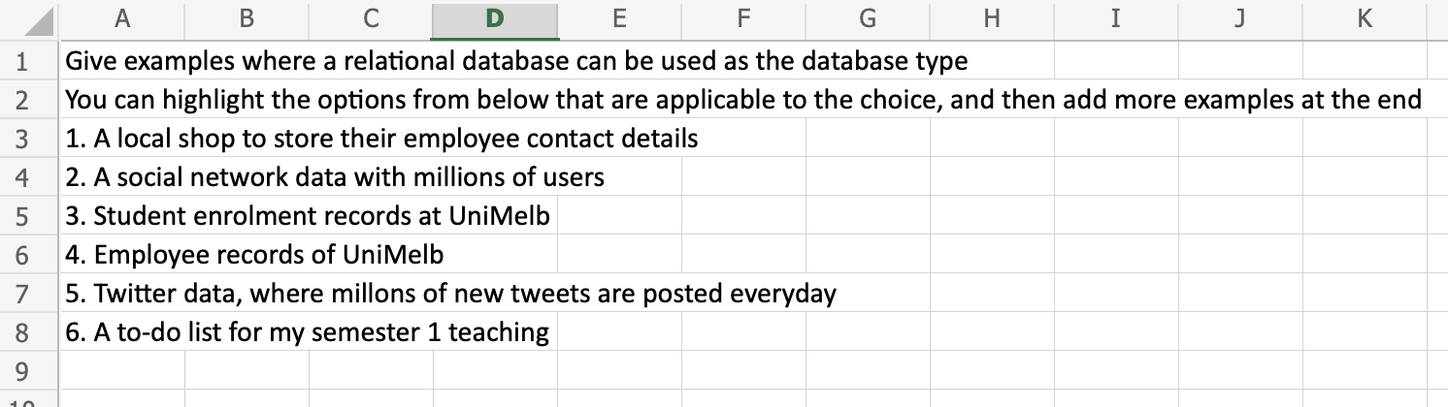
Time for breakout rooms!
tinyurl.com/yvxt9zbh

Slide 24
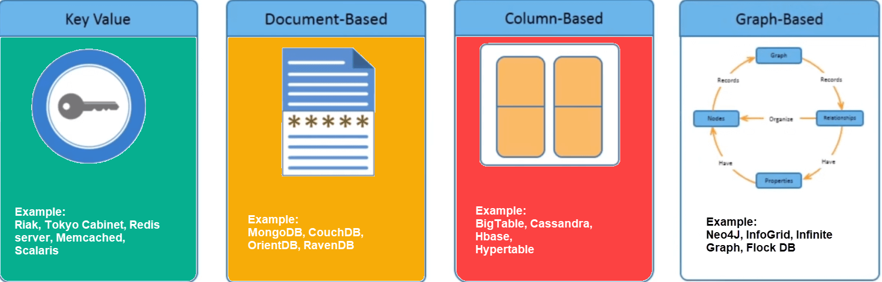
Types of NoSQL databases
Image source: https://jameskle.com/writes/no-sql
Examples and discussions in tutorials

Slide 25
Database Architectures
Centralized
Distributed
WWW
Grid
P2P
Cloud
Data stored in one location
Data distributed across several nodes, can be in different locations
Stored all over the world, several owners of the data
Like distributed, but each node manages own resource; system doesn’t act as a single unit.
Like grid, but nodes can join and leave network at will (unlike Grid)
Generalization of grid, but resources are accessed on-demand
Each architecture itself is quite a broad topic –
we will only look at what they are and a couple of important properties

Slide 26

Database Architectures
Cloud computing
Updated URL: https://youtu.be/mxT233EdY5c

Slide 27
More on Storage
Storage today does not come as one disk
They come as a system and increasingly complex
Storage systems can determine the performance and also fault tolerance of a database
In Database Management Systems (DBMSs), rarely data is stored in one location as well
Storage is now much larger, involves multiple disks, and accessed over a network and at many sites

Slide 28
More on Storage Systems
We will discuss the following types of storage systems
  RAID : Redundant Array of Independent Disks – different ways to combine multiple disks as a unit
  (Presented in pre-recorded lecture!)
  Storage Area Networks

Slide 29
Storage Area Networks (SAN)
A dedicated network of storage devices
Storage can be organized as RAID (Redundant Array of Inexpensive Disks) systems .
Storage is partitioned and allocated to each system and can also be shared.
System1
Sytem2
System3
Fiber (optical)
channels
SAN Controller and
Switch
A0
A1
A2
A3
P1
P2
A4
P3
P4
A5
A6
P5
P6
P7
P8
A7
A8
A9
A10
A11

Slide 30
More on SANs
They are used for shared-disk file systems
Automated backup functionality
It was the fundamental storage for data center type systems with mainframes for decades
Different versions evolved over time to allow for more data, but fundamentals are the same even today
But in short, failure probability of one disk is different than 100s of disks - which requires design choices

Slide 31
Fault Tolerance
The property that enables a system to continue operating properly in the event of the failure of some of its components.
We have covered
Statistics crash course
Lifecycle of a system
Different fault tolerance techniques

Slide 32

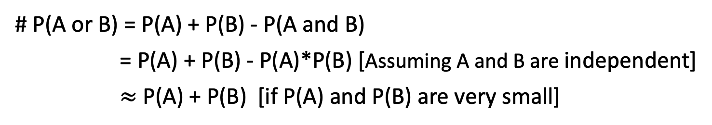
# P(A and B) = P(A)*P(B) assuming A and B are independent events.
# P(A or B) = P(A) + P(B) - P(A and B)
= P(A) + P(B) - P(A)*P(B) [Assuming A and B are independent]
$≈$ P(A) + P(B) [if P(A) and P(B) are very small]
Some activities on statistics!
PollEv.com/farhanachoud585

Slide 33
Fault tolerance by RAID
Redundant Array of Independent Disks – different ways to combine multiple disks as a unit for fault tolerance or performance improvement, or both of a database system
Choosing the suitable RAID level
The factors to consider:
Reliability
Performance
Storage utilization
Price/number of disks

Slide 34
Example summary: RAID 0 and RAID 2
A0
A1
b0
b1
A2
A3
b2
b3
A4
A5
b4
b5
A6
A7
b6
b7
Storage utilization?
Block level striping
Bit level striping (rare)
What is the minimum
number of disks needed?
Provides balanced I/O of disk drives
Provides higher throughput (~doubles)
Any disk failure will be catastrophic
MTTF reduces by a factor of 2
Higher throughput at the cost of increased vulnerability to failures
Calculation of MTTF values – in tutorials
Notes:
alternative

Slide 35
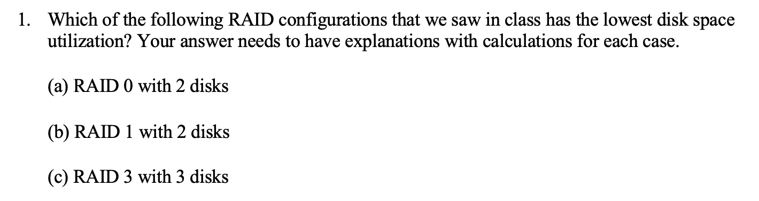
RAID – tutorial exercise
Notes:
alternative

Slide 36

Fault Tolerance by voting
Use more than one module, voting for higher reliability
Failvote - Stops if there are no majority agreement
Failfast (voting)- Similar to failvote except the system senses which modules are available and uses the majority of the available modules.
Supermodule – A system with multiple modules that use voting when multiple modules are working/available, but still work even when only one is available
100
100
1

Slide 37
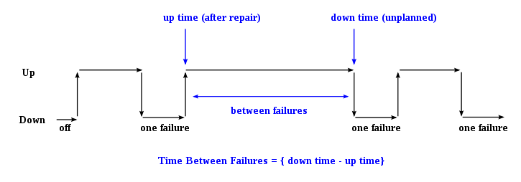
A system’s lifecycle
Module availability : measures the ratio of service accomplishment to elapsed time
Repair time
the time elapsing before a failure is experienced
Availability of a system: (i) Without repair (ii) With repair

Slide 38


Communication reliability
I will tell a story
Once upon a time…
Ack
Ack

Slide 39
Communication reliability
If acknowledgement not received -
I will tell a story
I will tell a story
I will tell a story

Slide 40
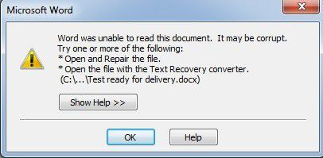
Disk writes
Either entire block is written correctly on disk or the contents of the block is unchanged.
What type of systems use duplex writes?
Difference with RAID 1?

Slide 41
Cyclic Redundancy Check (CRC)
An error detection algorithm
1. A polynomial needs to be specified
2. A sequence of bitwise exclusive-or (XOR) operation needs to be performed
3. The final CRC value needs to be stored for each data block (or the data unit on which CRC is performed)
4. Data correctness can be checked with CRC -
    a. its corresponding CRC value is retrieved
    b. A sequence of bitwise XOR operation needs to be performed to find out the correctness of data

Slide 42
Non-examinable resource:
Reliability, disk write reliability, RAID, CRC, etc. in use in real systems –
Dell EMC Unity (storage unit by Dell)
https://www.delltechnologies.com/asset/en-us/products/storage/industry-market/h17076-dell-emc-unity-data-integrity.pdf (duplex write is the same as synchronous replication in that document).

Slide 43
Summary
Performance and Reliability are important
Achieving reliability requires additional hardware/algorithms
- Effect of Hardware on performance – different memory hierarchy
- Hardware reliability
- Communication reliability
- Disk write reliability

